Slide 1
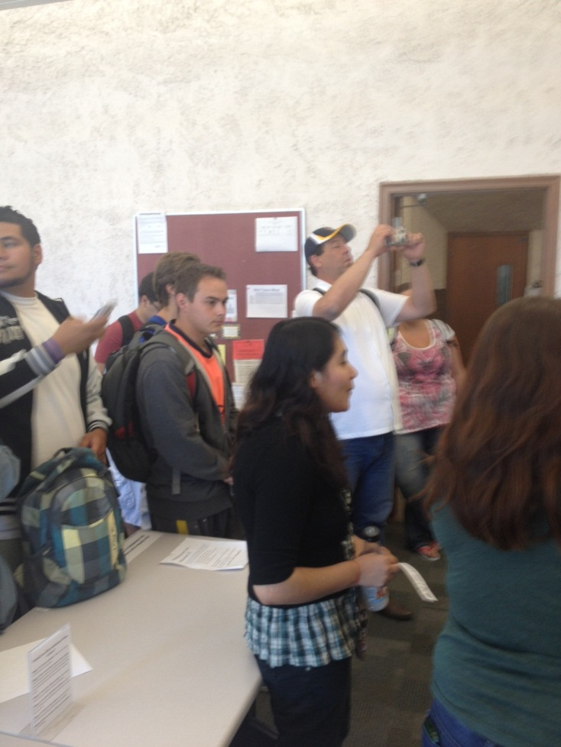
College Campus Tour

Slide 2
Student Employment
Career workshops
Free
Internships
Co-operative education

Slide 3
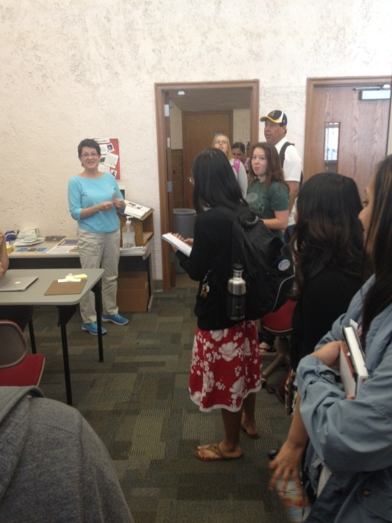
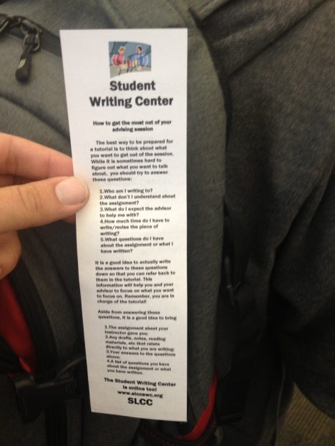
Writing Lab
Must make appointment
No printer in room
Tutoring available

Slide 4
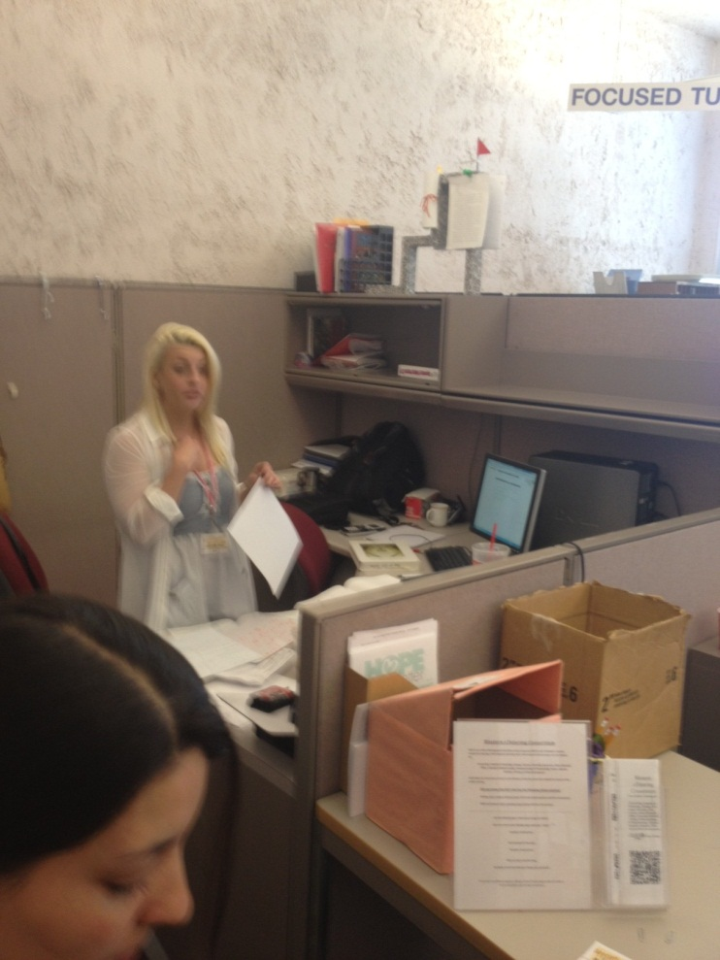
Learning Center
Tutoring for all math classes
Group and private tutors
Can do any homework
Quiet study area

Slide 5
Student Center
Computer lab
Printer
Cashier (tickets, tuition, etc.)
Food
ID Services

Slide 6
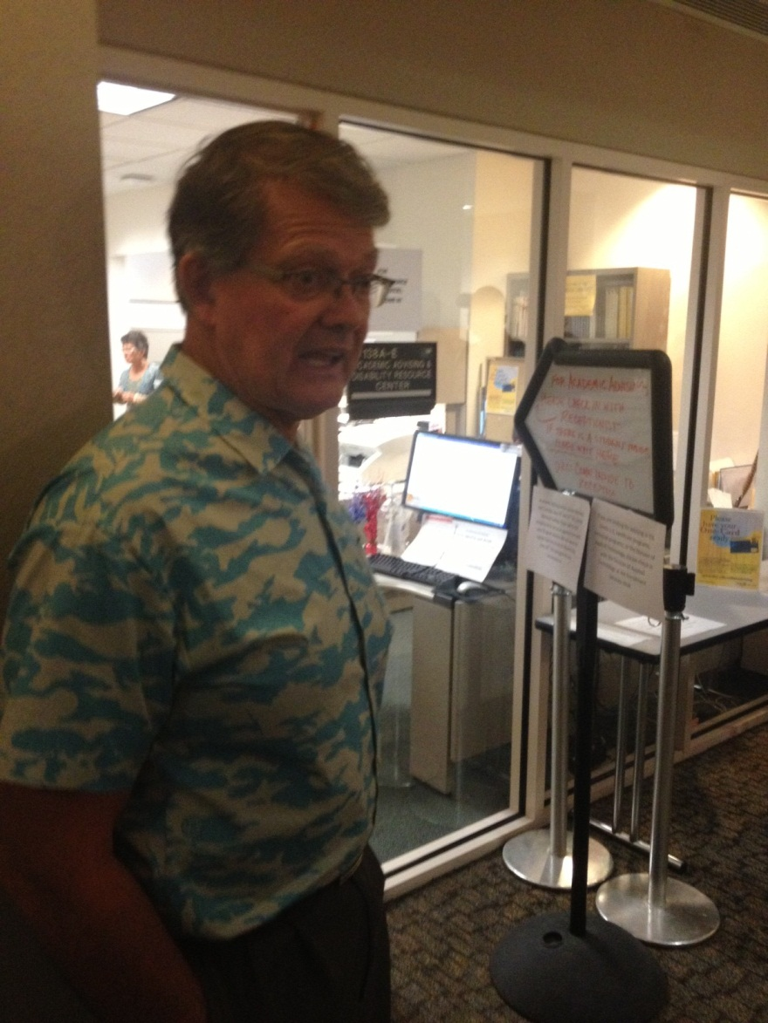
Academic Advising
Help set up classes
Plan for future
Decide on major
Transfer credits/degree
General advice

Slide 7
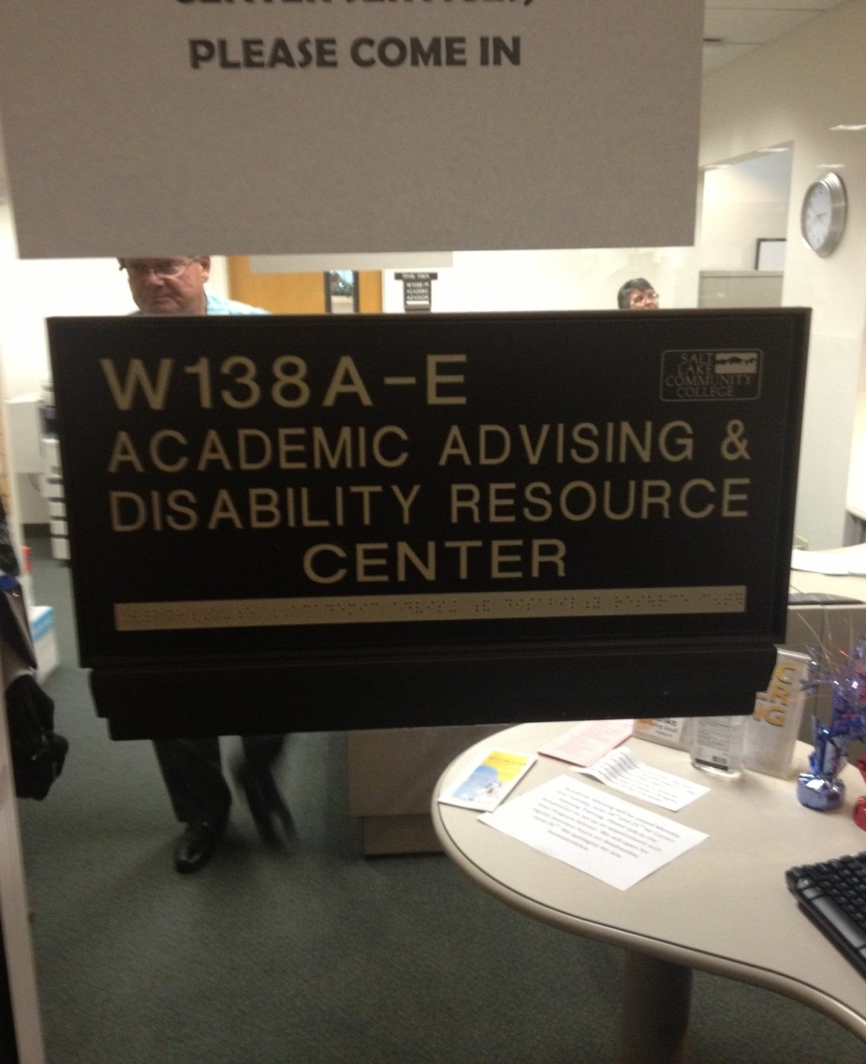
Disability Resource
Special help
Guidance
Nice people

Slide 8
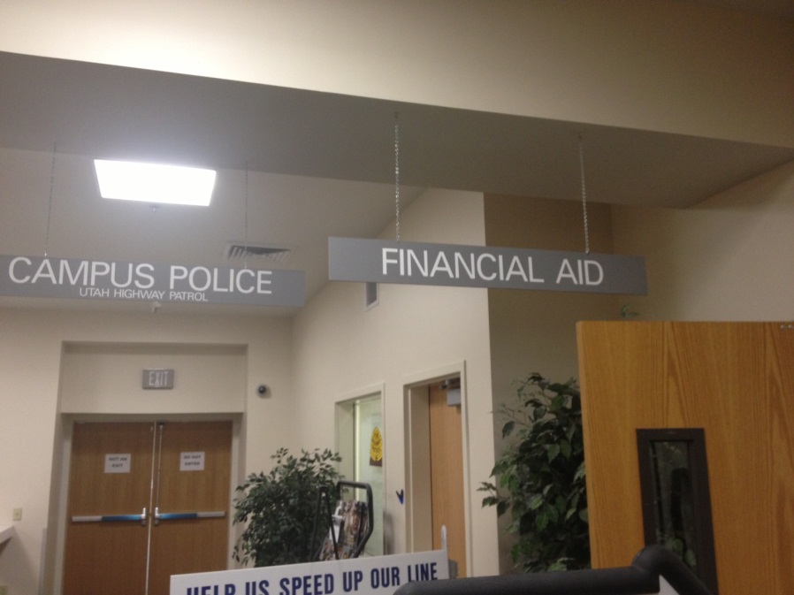
Financial Aid
Sign up for aid
Look at list of services
Grants
Scholarships
Government Aid
Daycare
Discounts

Slide 9
Student Activities/Clubs
Variety of extracurricular activities
Meet new people
New experiences
Enrich your life
Sports

Slide 10
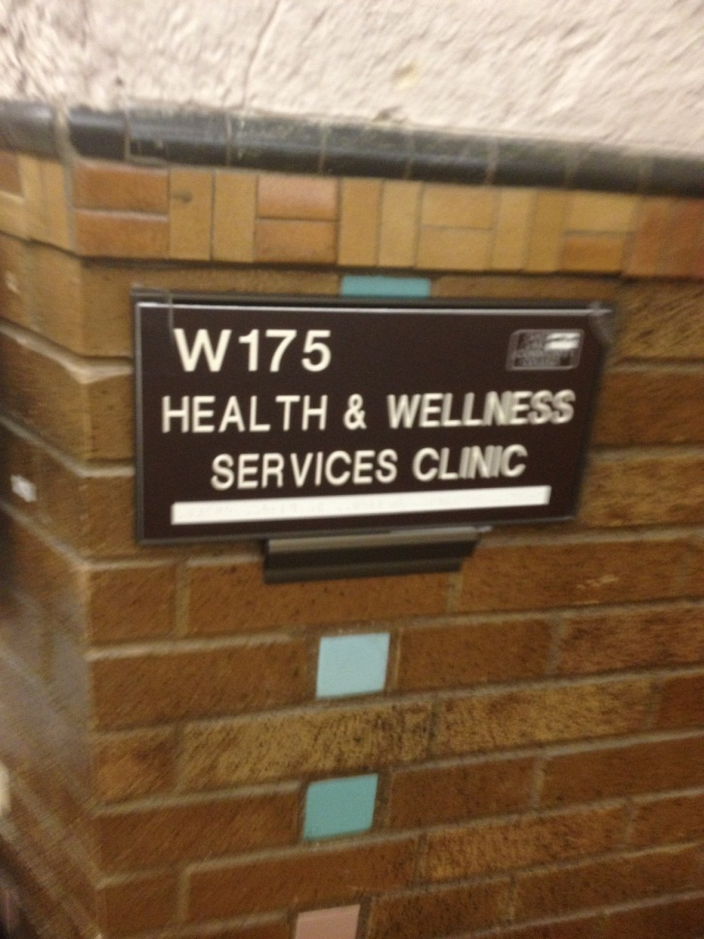
Health & Wellness
Free massages
Medical diagnosis
Lie down when you’re sick
Counseling

Slide 11
Thayne Center
Volunteering
Tutoring
Help encourage student success

Slide 12
Library
Buy textbooks
Supplies (pencils, notebooks, etc.)
Research
Study

